Slide 1
Introduction to ROS
Andy Ser, 2020/3/16
<number>

Slide 2
Outline
What is ROS?
Why using ROS?
ROS Concept
ROS Command Line Tools
ROS GUI
TF
<number>

Slide 3



What is ROS?
Robot Operating System
Actually not an operating system
Based on your real OS, do
hardware abstraction
low-level device control
messages passing between processes
package management
More suitable called as a ‘middleware’, a ‘framework’
<number>

Slide 4

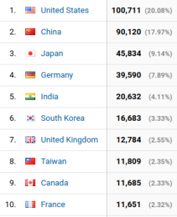
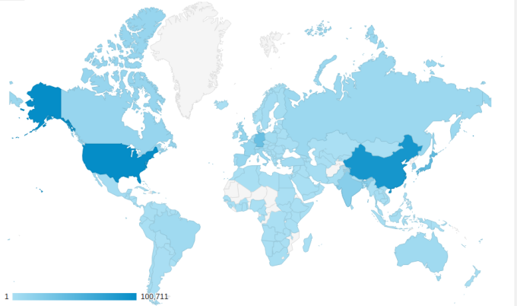
Why using ROS?
Open Source (BSD, maintaining by OSRF)
Cross-language, cross-plateform
Python, C++
Linux, Android, Matlab
Extensively useful tools
Command line tools
GUI
People care about it
Strong community
wiki.ros.org
answer.ros
Source: metrics_report_2017
<number>

Slide 5
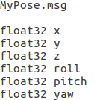
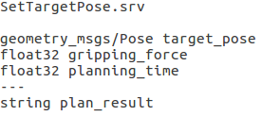
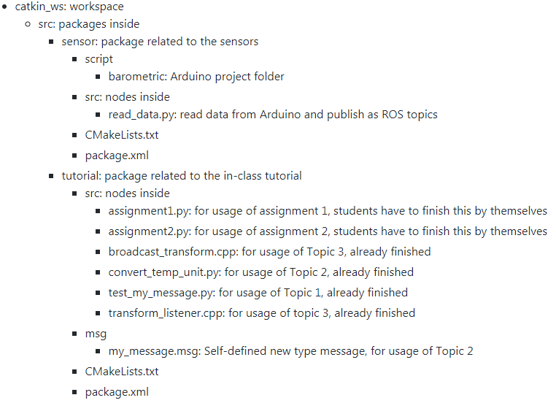
ROS Concept (1/2)
Filesystem
Package
Package Manifest
Message types (.msg)
Service types (.srv)
.msg example
.srv example
<number>

Slide 6
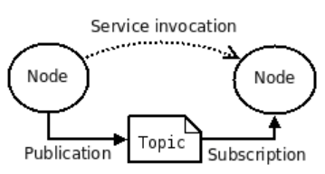
ROS Concept (2/2)
Computation Graph Level
Nodes
Processes that perform computation
Master
Name registration and lookup to the rest of computation graph
Parameter server
Stored data in central location
Messages
Nodes communicate with each other by passing messages
Simply a data structure
Topics
Node sends out a message by publishing it to a given topic
Node interested in a certain kind of data will subscribe to the topic
Services
Request/ Response behavior
source: ros concept
<number>

Slide 7
ROS Command Line Tools (1/3)
$ roscore: start up
a ROS master
a ROS parameter server
a rosout logging node
$ rosbag
A bag is a file format in ROS for storing ROS message data
info
play
record
<number>

Slide 8
ROS Command Line Tools (2/3)
$ rostopic: printing information about ROS topics
echo
hz
list
pub
$ rosmsg: printing information about ROS message types
show
list
$ rosnode: printing information about ROS nodes
list
info
<number>

Slide 9
Refer to: ROS command line tools
ROS Command Line Tools (3/3)
$ rosparam: operating on parameters from the server
set
get
list
$ rosrun: run the executable file from the package with arguments
$ rosrun PACKAGE EXECUTABLE [ARGS]
$ roslaunch
launch multiple nodes and set parameters on the parameter server
launch file is a XML-like file
Will be covered next week
$ rosservice
list
call
info
Will be covered next week
<number>

Slide 10
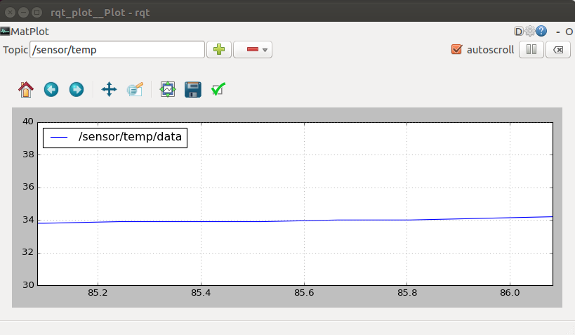
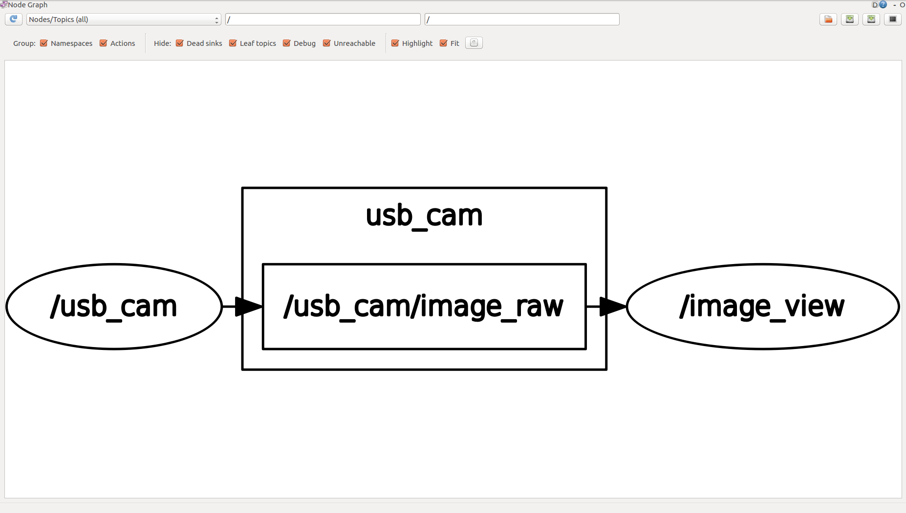
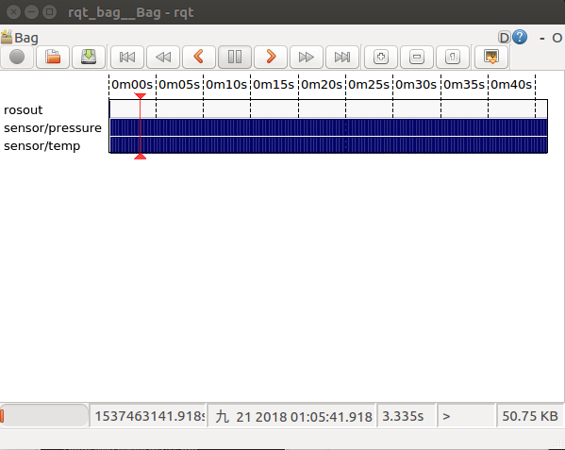
ROS GUI
rqt_plot
rviz: you may not be unfamiliar with it
image
pointcloud
robot model
marker
rqt_plot
data (Int/ Float) versus time
rqt_graph
nodes/ topics flow chart
rqt_bag
play/ record bag interface
rqt_graph
rqt_bag
<number>

Slide 11
Topic 1 & 2
<number>

Slide 12
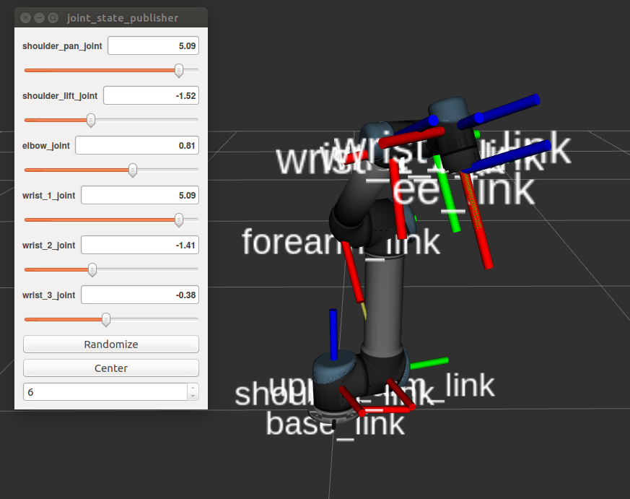
TF (1/2)
Transformation in 3D space
Directly affect what you see in rviz
Data structure
Frame ID
Parent frame ID
Time
Position: Vector3
Orientation: Quaternion
Broadcasting/ Listening
UR5 coordinate frame chain
Refer to: tf
<number>

Slide 13
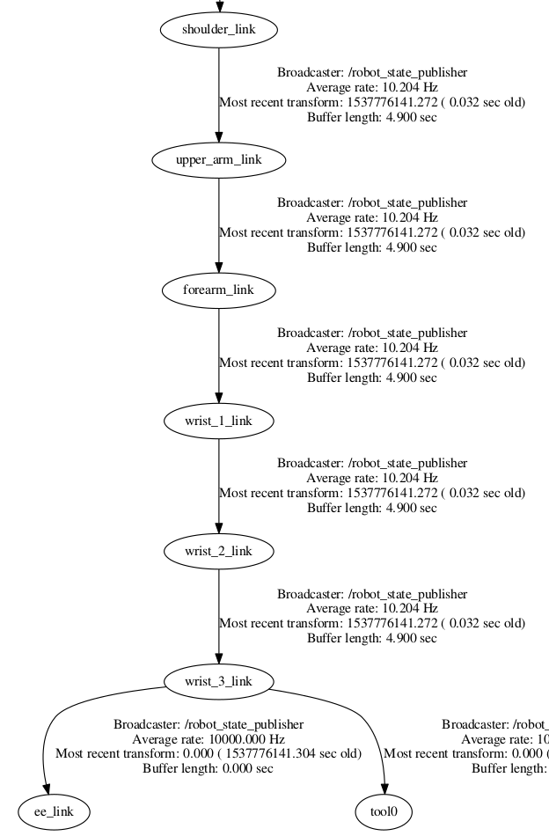
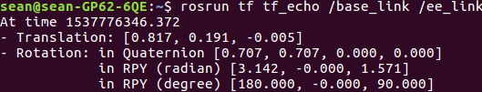
TF (2/2)
Also available some useful command line tools
view_frames
tf_echo
static_transform_publisher
confirm the relation between sensors
UR5 tf structure (part)
<number>

Slide 14
Topic 3
<number>

